Slide 1

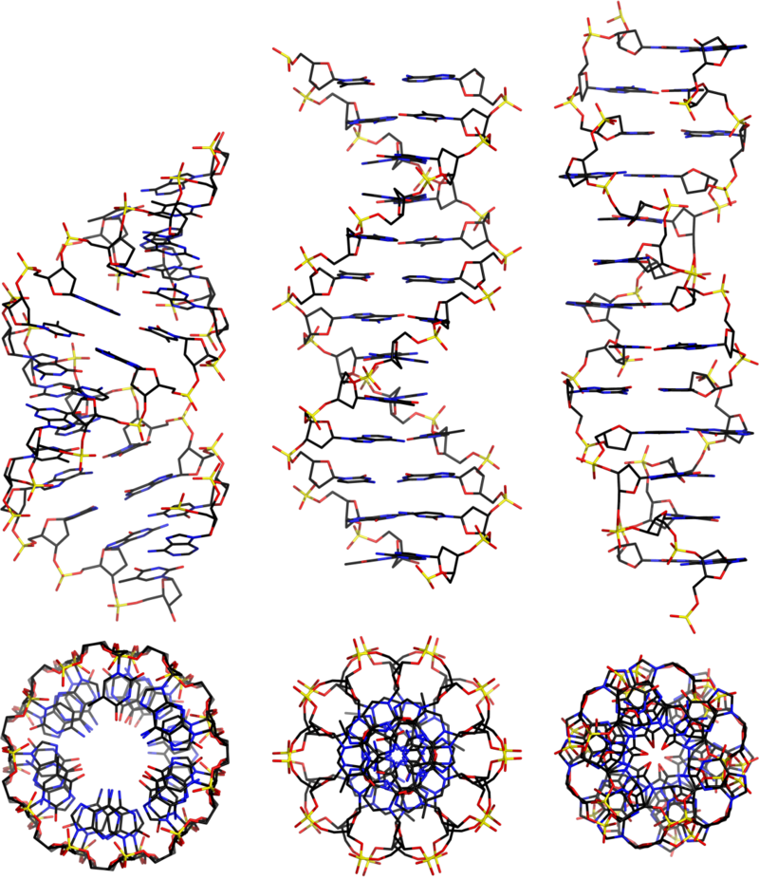
Comparison of helical dynamics of dsDNA and dsRNA: comparison of experimental and modeled data
Notes:
Hello everyone, today I will share with you the progress of my master-thesis. Today’s theme is Comparison of helical dynamics of dsDNA and dsRNA: comparison of experimental and modeled data. This work focus on finding out their conformational information using orientation-selective PELDOR.

Slide 2
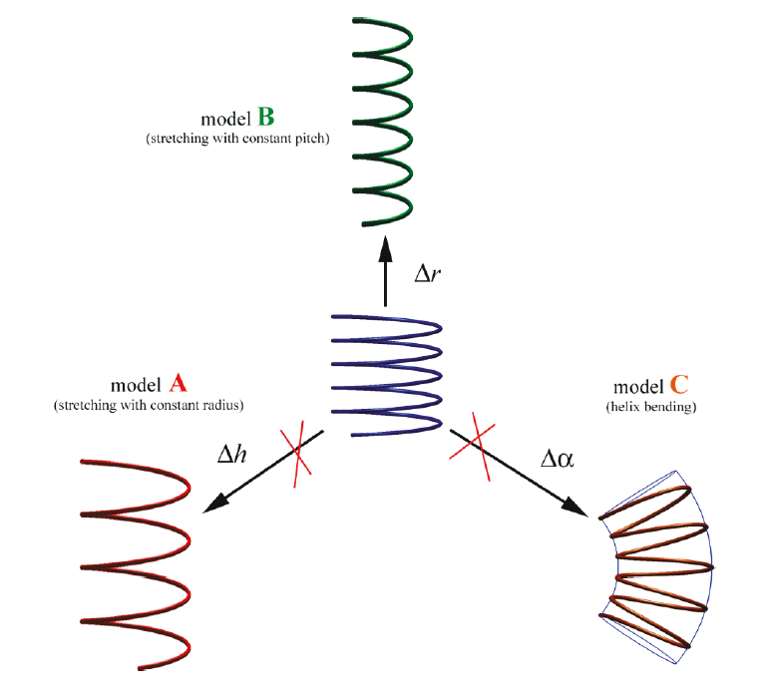
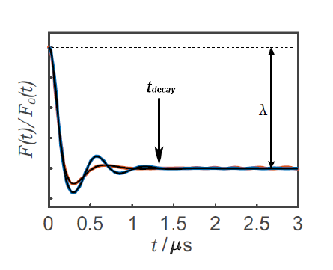
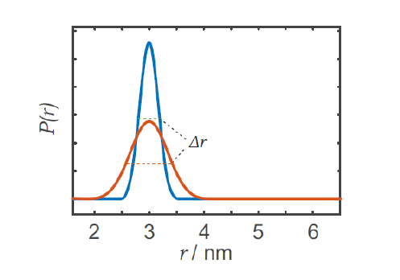
Motivation and Content
Motivation
Reconstruct three models for dsDNA
Apply models to dsRNA
Content
Introduction of the helix-model (A/B)
Introduction of the spin flexibility
Exp. PELDOR vs. simulated PELDOR
dsDNA/dsRNA
Different Spin labels
Summary and Outlook
Marko, A., Denysenkov, V. P., Margraf, D., Cekan, P., Schiemann, O., Sigurdsson, S. Th. and Prisner, T. F.(2011), Conformational Flexibility of DNA. J. Am. Chem.
Notes:
Compared to RNA, the structure of DNA is easier and well understood. Our previous co-worker AM had designed three different dynamic models for dsDNA, model A is stretching with constant radius, model B is stretching constant pitch, and the model C is helical bending. And AM had already found that the predicted PELDOR time traces with model B were in best agreement with the experimental ones. The first goal is to reconstruct these different dynamic DNA models and simulate the corresponding PELDOR data to see if the result matches that of AM. The second goal is to study the dsRNA with these modified models. By this time, I had completed model A and model B. Before I present how I design my Helics model, let me give you some foundamental information.

Slide 3
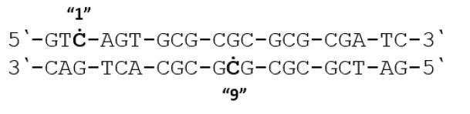
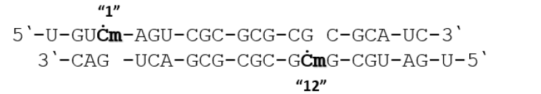
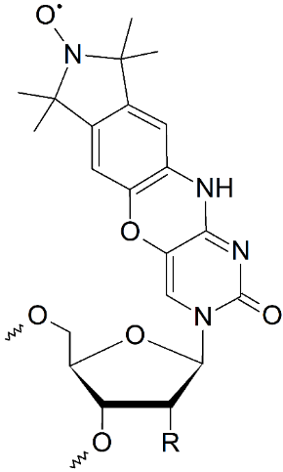
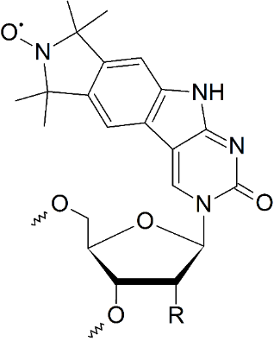
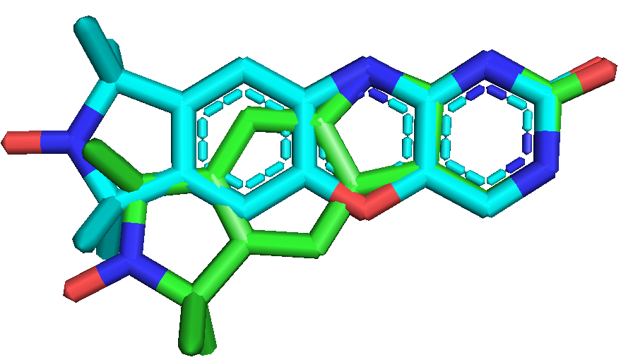
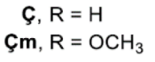
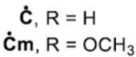
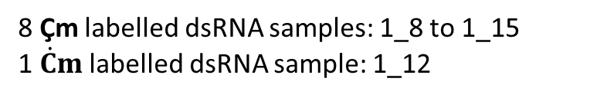
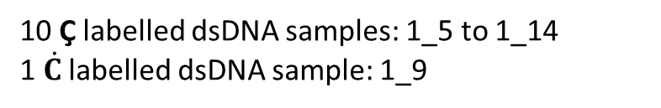
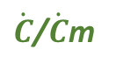
dsDNA/dsRNA in-vitro samples
10 Ç labelled dsDNA samples: 1_5 to 1_14
1 $\dot{C}$ labelled dsDNA sample: 1_9
8 Çm labelled dsRNA samples: 1_8 to 1_15
1 $\dot{C}m$ labelled dsRNA sample: 1_12
Ç/Çm
$\dot{C}$/$\dot{C}$m
Notes:
First I introduce u our samples, we have two types of labels, one is called C/Cm, the other is called Cdot/Cmdot, the small m indicates attached to RNA. And we always named the samples like 1_5; the first number "one" refers to the first label, who was always embedded in the third nucleotide, and the second number means the relative position of the second label in the complementary strand. Here is the chemical structure and the geometry of two types spin labels, one is very straight, the other is bent 27 degrees. But both are rigid.

Slide 4
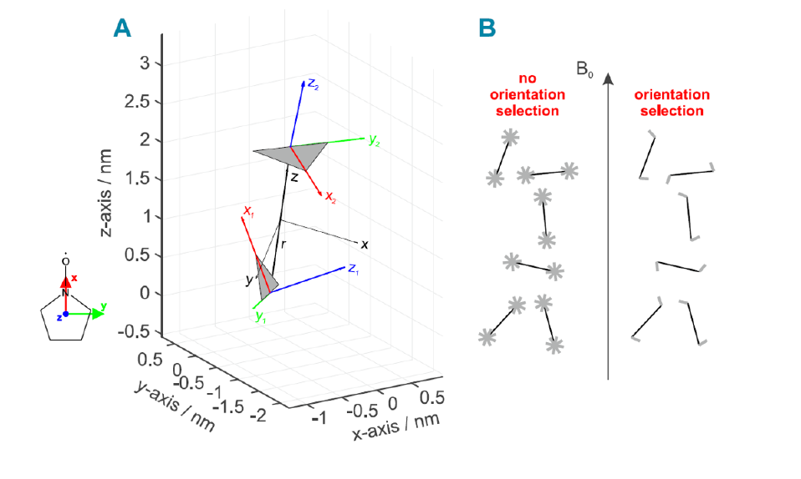
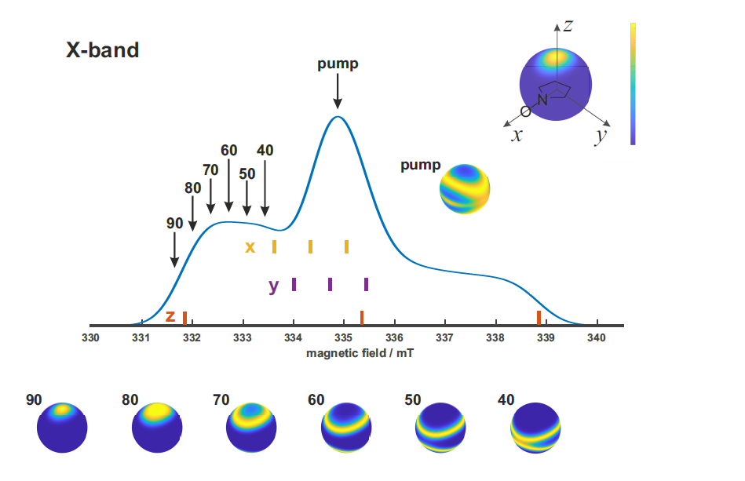
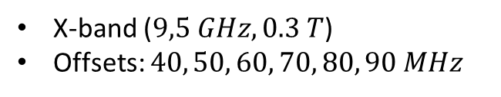
Orientation-selective PELDOR
Excitation possibility
Rigid labels allows the orientation-selection
X-band ($9,5 GHz, 0.3 T$)
Offsets: $40, 50, 60, 70, 80, 90 MHz$
Notes:
And rigid spin labels allow us to perform orientation-selective PELDOR. If the PELDOR experiment exhibits no orientation selection, all orientations of spin labels can be probed by the detection sequence and not distinguished, which means that the Euler angles of their molecular axis relative to dipolar frame can be randomly distributed. When rigid spin labels are introduced, their Euler angles are fixed and their mutual orientation is determined only by the conformation of the molecule itself. In such a case, a set of orientations of biomolecule can be selected by the pump pulse and detection pulse. And today’s results are from X-band field where the experiment is repeated six times increasing the frequency offset from 40 to 90 MHz in steps of 10 MHz.

Slide 5
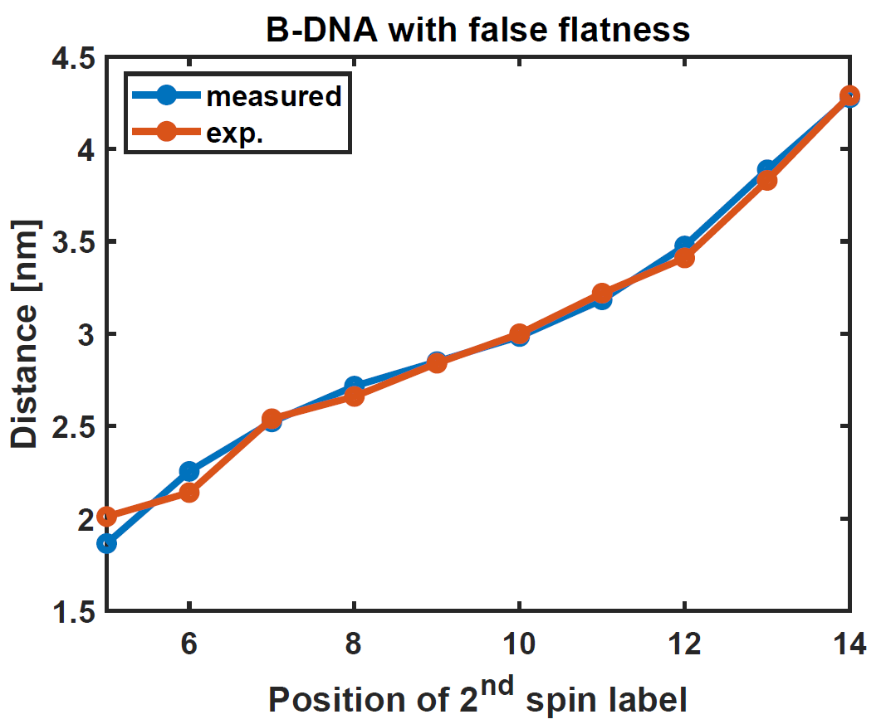
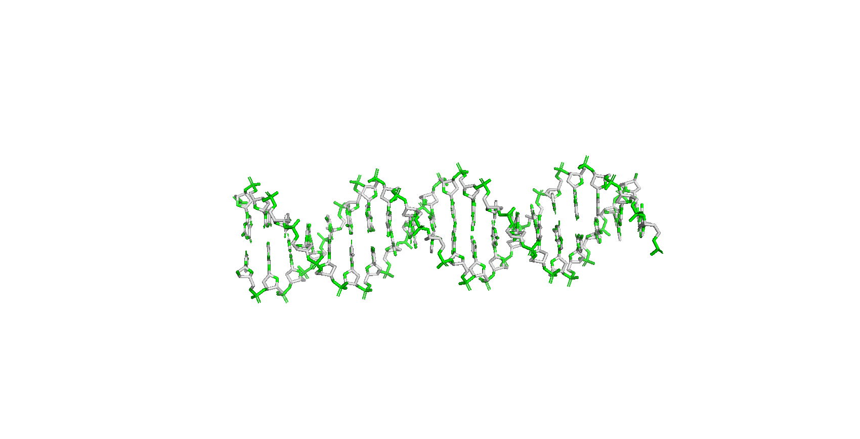
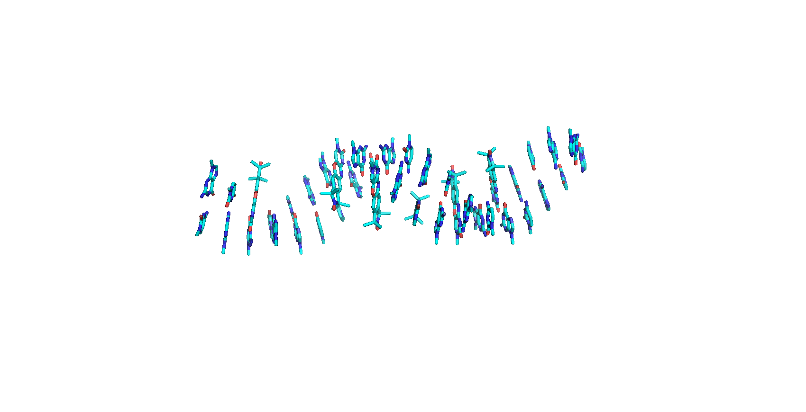
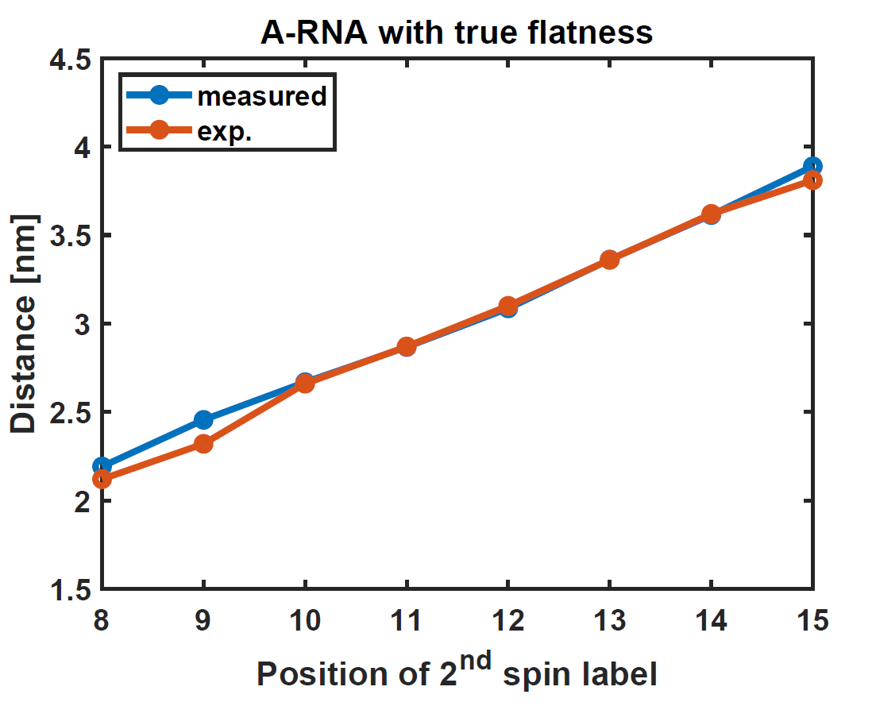
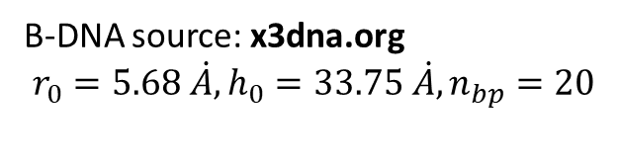
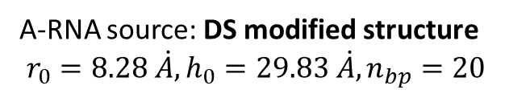
Choice of DNA/RNA structure
B-DNA source: x3dna.org
$$r_{0}=5.68 \dot{A},h_{0}=33.75 \dot{A}, n_{bp}=20$$
A-RNA source: DS modified structure
$$r_{0}=8.28 \dot{A}, h_{0}=29.83 \dot{A}, n_{bp}=20$$
Notes:
To be able to design the dynamic model, it is also important to find a good starting structure. For my work the DNA source is from the web x3dna.org, it is a B-DNA helix with false flatness, false flatness means that the base pairs are not parallel to each other but tilted. The A-RNA source was constructed by my colleague Deniz and has true flatness so their base are parallel to each other. Both helices consist of 20 base pairs. As you can see, the measured distance between both labels in different positions agree well with the exp. Mean_Distance, when DNA or RNA are static. We can now focus on how to add dynamics to them.

Slide 6
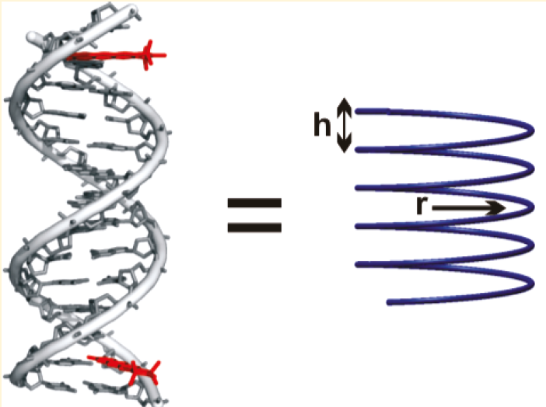
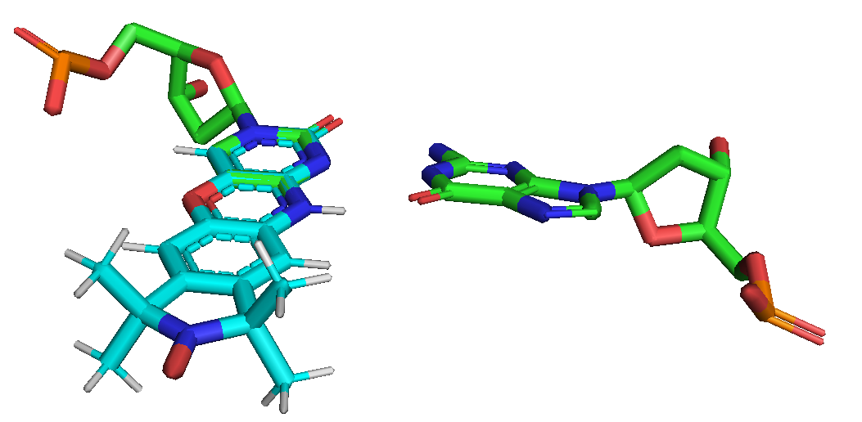
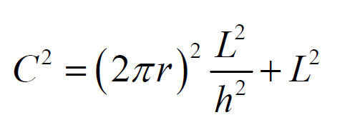
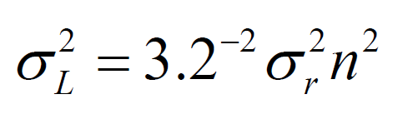
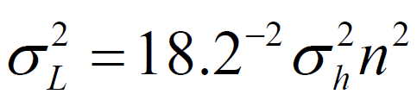
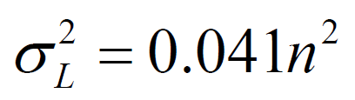
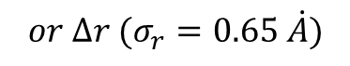
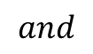
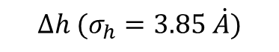
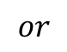
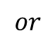
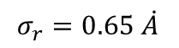
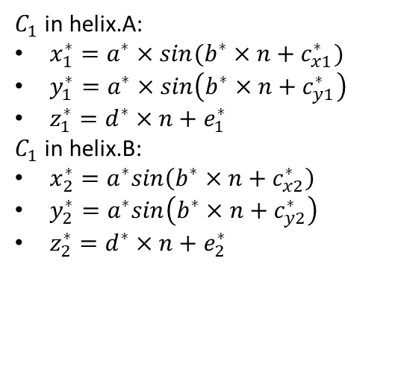
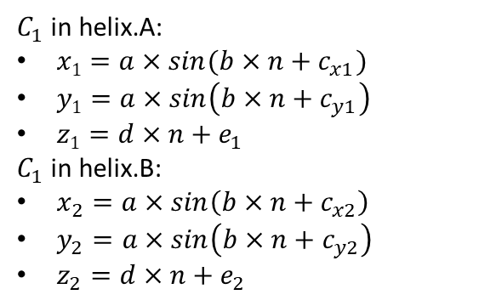
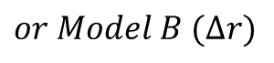
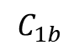
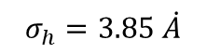
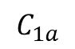

Helix dynamics definition
$$C_{1a}$$
$$C_{1b}$$
$$∆h (σ_{h}=3.85 \dot{A})$$
$$or ∆r (σ_{r}=0.65 \dot{A})$$
$$or$$
$$or$$
Curve fitting tool
SAXSI
$C_{1}$in helix.A:
$x1=a×sin(b×n+c_{x1})$
$y1=a×sin\left(b×n+c_{y1}\right)$
$z1=d×n+e_{1}$
$C_{1}$in helix.B:
$x_{2}=a×sin\left(b×n+c_{x2}\right)$
$y_{2}=a×sin\left(b×n+c_{y2}\right)$
$z_{2}=d×n+e_{2}$
$C_{1}$in helix.A:
$x_{1}^{∗}=a^{∗}×sin(b^{∗}×n+c_{x1}^{∗})$
$y_{1}^{∗}=a^{∗}×sin\left(b^{∗}×n+c_{y1}^{∗}\right)$
$z_{1}^{∗}=d^{∗}×n+e_{1}^{∗}$
$C_{1}$in helix.B:
$x_{2}^{∗}=a^{∗}sin\left(b^{∗}×n+c_{x2}^{∗}\right)$
$y_{2}^{∗}=a^{∗}sin\left(b^{∗}×n+c_{y2}^{∗}\right)$
$z_{2}^{∗}=d^{∗}×n+e_{2}^{∗}$
$$Model A (∆h)$$
$$or Model B (∆r)$$
$$σ_{r}=0.65 \dot{A}$$
$$and$$
$$σ_{h}=3.85 \dot{A}$$
Mathew-Fenn, R. S.; Das, R.; Harbury, P. A. B. Science 2008, 322, 446-449.
Notes:
To simplify the calculation, I did not use the whole helix, but only the C1 points connecting the deoxyribose backbone and the base. Under this assumption, we have two helices consisting of 20 C1 points. We extract their coordinates and represent them with the following equations using the curve fitting tool. After applying the dynamics, all parameters are changed but could be calculated. So we have coordiantes of the new helixs. In both models A and B, we have assumed that the contour length C of the helix curve remains constant and is related to the radius, the pitch and the length L from end to end. So, a small change in radius or pitch around equilibrium will result in a small change in L. And the SAXSI experiment from mathew-fenn’s work states the relationship between the length variation and the base pair number, combining these equations, the values of delta_r/h can be determined.

Slide 7
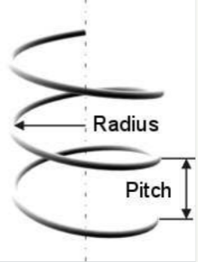
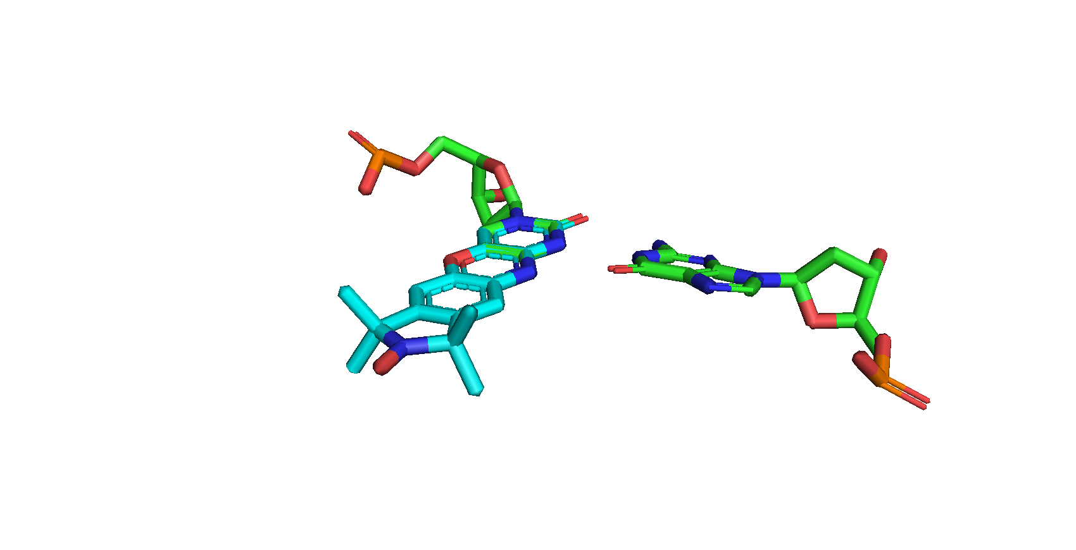
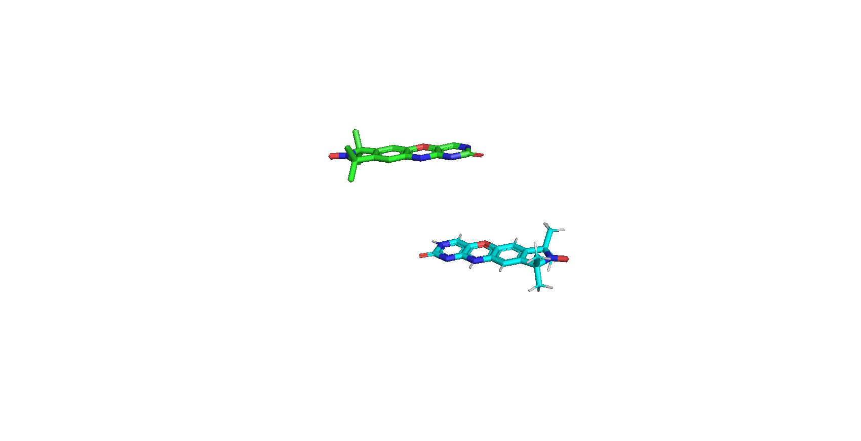
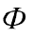
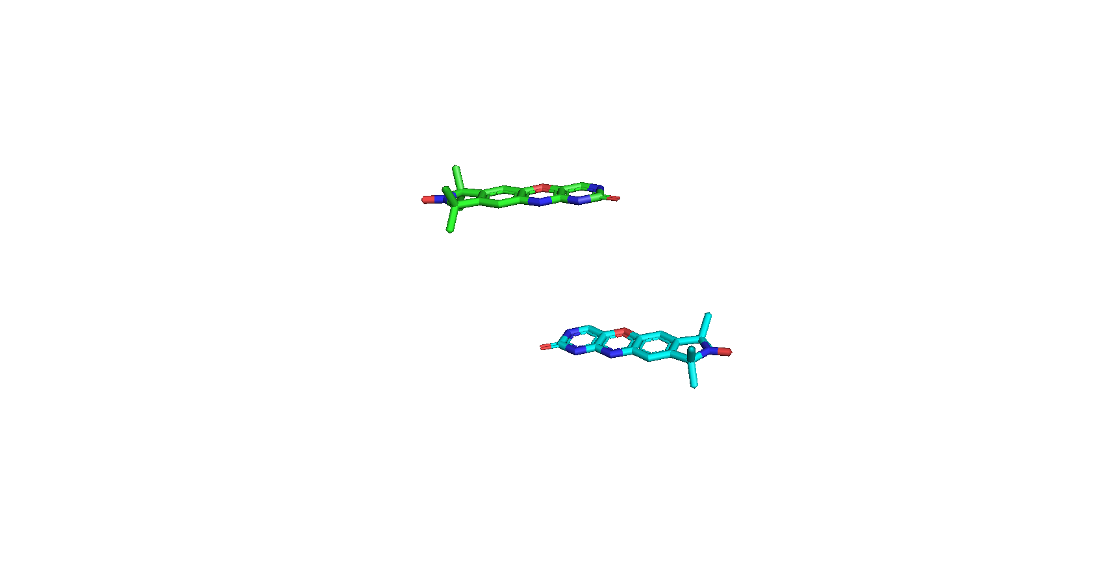
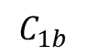
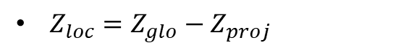

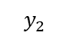
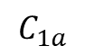

















Spin label geometry
$$Z_{loc}$$
$$Z_{glo}$$
$$Z_{glo}$$
$$Z_{loc}$$
$$C_{1a}$$
$$Z_{proj}$$
$$C_{1}−axis$$
$$C_{1b}$$
$$α$$
$Z_{loc}=Z_{glo}−Z_{proj}$
$$β$$
$$z_{1}$$
$$x_{1}$$
$$y_{1}$$
B₀
$$z$$
For B-DNA: $α≈76.2°; β≈6.5°$
For A-RNA: $α=74\sim 78°; β=3.5\sim 5.2°$
Distance ($C_{1a}$ to spin) $=11.4 \dot{A}$
$$θ$$
$$y$$
R
$$x$$
$$x_{2}$$
$$y_{2}$$
$$z_{2}$$
Notes:
In the second step, the electron spin position of the spin label and their mutual orientation were constructed from the helix. To find where the electron spin is, two rotations are required. But first we should define a local z-axis for the following rotation.
I defined the axis that crosses the entire helical cylinder as the global z-axis. For static B-DNA, the local z-axis is almost equal to the global z-axis, but for RNA or moving DNA, the z_glo axis is no longer perpendicular to the C1 axis. So we simply perform a projection of Z_glo onto the C1 axis and subtract Z_proj from Z_glo, then we obtain Z_loc.
The first rotation starts with the C1 vector and goes around the local z-axis with alpha. Additionally, a rotation by beta was performed around the normal vector of the plane between the z-axis and the new vector. The resulting vector starts from the C1a atom in the direction of the electron spin. Since we know their distance is 11.4 A, the coordinates of the electron spin are determined. With these two vectors, the total spin label geometry could also be calculated.
Now we have the coordinate system of the nitroxide and it can be transformed to distances and Euler angles with respect to dipolar frame in order to simulate the PELDOR time traces.
Next I will you the distance distribution through the moving B-DNA.

Slide 8







Distance distribution by B-DNA (helix-dynamics)
(1,5)
(1,6)
(1,7)
(1,8)
(1,10)
(1,9)
(1,11)
(1,14)
(1,13)
(1,12)
model A (stretching with constant radius): $h=h_{0}+∆h (σ_{h}=3.85 A)$
(1,9)
(1,8)
(1,10)
(1,7)
(1,11)
model B (stretching with constant pitch): $r=r_{0}+∆r (σ_{r}=0.65 A)$
(1,6)
(1,5)
(1,12)
(1,13)
(1,14)
Notes:
This is the case of model A. The distribution is Gaussian fitted and the probability is normalized so that all areas of the peaks are equal to 1. We can observe that the peaks at samples 1_5 and 1_6 are very narrow, so we can imagine that we will see a very strong oscillation in the PELDOR time trace because these conformeres have almost same distance. And the samples in the middle range are very broad, so the PELDOR can be very damped. In the contrast, the distribution in model B is quite different. Model B shows a broad peak for short distance samples and narrow peaks for the middle distance samples. Thus, in model B, we can expect inverse PELDOR development for samples 1_5 to 1_11 compared to model A.
So let's see their PELDOR data.

Slide 9


PELDOR by dsDNA (model A vs. model B)
Notes:
Top has always been the result using model A and the bottom has always been model B
As predicted, 1_5 and 1_6 with model A are strongly oscillated, but this not happed in Model B.

Slide 10
PELDOR by dsDNA (model A vs. model B)
Notes:
In the middle range, Model A shows damped PELDOR, while model B has a strongly oscillating time trace.

Slide 11
PELDOR by dsDNA (model A vs. model B)
Notes:
For the rest, there is also a difference in the rest can be seen. These data are as expected when we think about their distance distribution: a narrow peak corresponds to an oscillating PELDOR and a broad peak to a damped PELDOR.

Slide 12
PELDOR by dsDNA (model A vs. model B)
Compensation required for the oscillation
Notes:
These data are as expected when we think about their distance distribution: a narrow peak corresponds to an oscillating PELDOR and a broad peak to a damped PELDOR.
But the oscillation in PELDOR could be compensated. For this compensation I will then introduce the spin flexibility.

Slide 13












Spin flexibility
Z
Internal mobility:
$X−rotation=0°$
$Y−rotation=±6° \left(for \text{Ç}_DNA\right);$
$$±4° (for \text{Ç}\text{m}\text{_}RNA);$$
$Z−rotation=±5°$
Gaussian-distributed angle variations
Y
$$z_{1}$$
$$x_{1}$$
X
$$y_{1}$$
B₀
$$z$$
$$θ$$
$$y$$
R
$$x$$
$$x_{2}$$
$$y_{2}$$
$$z_{2}$$
Notes:
To account for the internal mobility of Spin, we have introduced additional rotational motions around the molecular axis of the spin label. The first rotation around the x-axis is not considered because this type of spin label C/Cdot is rigid around this direction. The rotation about the y-axis has a stronger effect on the damping of the PELDOR oscillation, and I found this value as 6 for DNA, 4 for RNA after many attempts. The angular fluctuation about the z-axi was fixed to 5 degrees but have only 10 factor less effect than y-rotation. All these motions are calculated independently and based on Gassian distributed angular fluctuations. After that, we calculate distance and Euler angle again.
Let’s see their PELDOR after applying this motion.

Slide 14







PELDOR by dsDNA (helix-dynamics & spin motions)
$$z=5°$$
$$y=6°$$
$$x=0°$$
$(°)$ = rotation angle$δ$ around y-axis
Notes:
The result of 1_5 and 1_6 were not better. This is probably because their distance is too short so that
the dipole-point approximation no longer works and it broke our exp. data.

Slide 15
PELDOR by dsDNA (helix-dynamics & spin motions)
$$z=5°$$
$$y=6°$$
$$x=0°$$
$(°)$ = rotation angle$δ$ around y-axis
Notes:
For model B, the results in the middle distance agree well with exp, while the predicted PEDLRO are getting worse in model A. This is because their PELDOR were very damped and this motion only makes them more damped.

Slide 16
PELDOR by dsDNA (helix-dynamics & spin motions)
$$z=5°$$
$$y=6°$$
$$x=0°$$
$(°)$ = rotation angle$δ$ around y-axis
Notes:
For the rest samples, the difference in PELDOR is not so obvious. next we further compare their individual distance distribution.

Slide 17
PELDOR by dsDNA (helix-dynamics & spin motions)
$$z=5°$$
$$y=6°$$
$$x=0°$$
$(°)$ = rotation angle$δ$ around y-axis

Slide 18


Distance distribution by dsDNA
$$z=5°$$
$$y=6°$$
$$x=0°$$
Predicted: Gauss-fitted
Exp.: Tikhonov-fitted
Notes:
The predicted histogram was fitted in Gaussian in the blue line. And the exp. Data were fitted with Tikhonov regularization in black line. Same, the first two sample fit not at all.

Slide 19
Distance distribution by dsDNA
$$z=5°$$
$$y=6°$$
$$x=0°$$
Predicted: Gauss-fitted
Exp.: Tikhonov-fitted
Notes:
In model A, these three predicted histogram are quite wide and cover the exp.ones completely., while in model B they fit very well.

Slide 20
Distance distribution by dsDNA
$$z=5°$$
$$y=6°$$
$$x=0°$$
Predicted: Gauss-fitted
Exp.: Tikhonov-fitted
Notes:
And here are the rest of samples. To summarize these comparisons clearly, I calculated their half-width.

Slide 21
Distance distribution by dsDNA
$$z=5°$$
$$y=6°$$
$$x=0°$$
Model B & spin motion predicted PELDOR data well
DNA samples were in B-Form
Notes:
To summarize these comparisons, I have calculated the mean distance and Full width at half maximum. The mean distance is not distinguished. But for the width, we can see that model B has a better agreement than model A. So if we combine the distribution and PELDOR time traces, we can conclude that model B gives a better prediction and the dsDNA samples are then in the form of B-DNA. Then, the DNA part is finished.

Slide 22







Distance distribution by A-RNA (helix-dynamics)
(1,8)
(1,9)
(1,10)
(1,11)
(1,12)
$$σ_{r}=0.81 \dot{A}$$
(1,13)
(1,14)
$$and$$
(1,15)
$$σ_{h}=4.25 \dot{A}$$
model A (stretching with constant radius): $h=h_{0}+∆h (σ_{h}=4.25 A)$
(1,10)
(1,9)
(1,11)
(1,8)
(1,12)
(1,13)
(1,14)
(1,15)
model B (stretching with constant pitch): $r=r_{0}+∆r (σ_{r}=0.81 A)$
Notes:
As for RNA, we have no indication of the length change of its helix, so I simply used the same length change of DNA to calculate its sigma value. For RNA there are no obvious differences between model A and B. Their probability is quite similar and small. Therefore, we are able to predict that there would be no large changes in PELDOR when we switched the model.

Slide 23


B-helix vs. A-helix
B-helix
A-helix
.O-N
N-O.
N-O.
.O-N
B-helix cause strong change in distance distributions than A-helix
Notes:
If we observe these spin-label pairs from above and put them into a circle, we will find the reason. In the B helix the N-O bond pairs look like directed outward, so a different DNA motion in a same labelling position can cause a quiet different effect. In the A helix, on the other hand, the N-O bond faces inward, so the change in RNA motion causes no visible change in distance distribution. This explains why, in DNA, the distributions in the different models are clearly distinguishable, which is not the case in RNA.

Slide 24



PELDOR by dsRNA (helix-dynamics & spin motions)
$$z=5°$$
$$y=4°$$
$$x=0°$$
Notes:
Now it is the RNA data, the y-rotation is reduced to 4 degrees. As said, it is not obvious to differentiate them, let’s take a view.

Slide 25
PELDOR by dsRNA (helix-dynamics & spin motions)
$$z=5°$$
$$y=4°$$
$$x=0°$$
Notes:
Similar for the middle three samples.

Slide 26
PELDOR by dsRNA (helix-dynamics & spin motions)
$$z=5°$$
$$y=4°$$
$$x=0°$$
Notes:
And the long distance samples both do not fit well

Slide 27


Distance distribution by dsRNA
$$z=5°$$
$$y=4°$$
$$x=0°$$
Notes:
In a same way, we compare their individual distance distribution. For first there only the sample 1_8 is little distinguished.

Slide 28
Distance distribution by dsRNA
$$z=5°$$
$$y=4°$$
$$x=0°$$
Notes:
You can notice for 1_11 model B fits better, but with a single case can not draw a conclusion.

Slide 29
Distance distribution by dsRNA
$$z=5°$$
$$y=4°$$
$$x=0°$$
For RNA, the model A/B is not distinguished
Notes:
Similarly, we calculate the FWHM, and as predicted, for RNA we can only say that model A/B is not distinguished.

Slide 30






Comparison of different spin labels at dsDNA
$$z=5°$$
$$y=6°$$
$$x=0°$$
Notes:
Lastly, I would like to show the case where i have changed the type of spin label. For Cdot_labelled DNA with 6 degrees y-rotation, the predicted peak is a bit narrow, I have tried, the result with 8 degrees will fit better.

Slide 31



Comparison of different spin labels at dsRNA
$$z=5°$$
$$y=4°$$
$$x=0°$$
Notes:
But this doesn’t occur in Cmdot labelled RNA, the 4-degree Y-rotation is not bad, whether in model A or in model B.

Slide 32

Comparison of different spin labels at dsRNA
$$z=5°$$
$$y=4°$$
$$x=0°$$
$\dot{C}/\dot{C}$m has more flexibility than Ç/Çm?
Notes:
So it is interesting to ask whether 𝐂 ̇/𝐂 ̇m is more flexible than Ç/Çm? But we only have data for one labelling position, so no conclusion can be drawn.

Slide 33





Summary and Outlook
Summary
For DNA, model B predicted PELDOR data well, dsDNA samples are in B-Form
For RNA, the model A/B is not distinguished
(1,9)
(1,8)
(1,10)
(1,11)
(1,7)
(1,6)
(1,5)
(1,12)
(1,13)
(1,14)
Outlook
Complete model C
Combine model A with B for RNA
Simulate PELDOR by A’-RNA
PELDOR with $\dot{C}/\dot{C}$m in other positions
Model B by Ç_DNA
(1,10)
(1,9)
A’
(1,11)
(1,8)
(1,12)
A
(1,5)
(1,6)
(1,7)
(1,13)
(1,14)
Model B by $\dot{C}$_DNA
Notes:
In summary, i have successfully created the helix model A/B for DNA and RNA. And for DNA, we can say that model B with spin motion predicts the PELDOR data well, dsDNA samples are in B-form. For RNA, the model A/B is indistinguishable. For future work, I will first complete model C, the bending model, and try to combine model A with B for RNA to see if the PELDOR data fits better. Also, I will simulate PELDOR with A’-RNA, which has a longer length than A RNA, to see if there is a difference due to the different helix structure. Finally, it is also interesting to carry PELDOR with C/𝐂 ̇m in other positions to compare their flexibility with C/Cm.

Slide 34

Acknowledgements
Maximilian Gauger
Prof. Dr. Thomas Prisner
Dr. Deniz Sezer
Thank you for your attention!
Notes:
So, that's all, and I would like to thank my superior Max, Deniz and Thomas for their support. And thank you for your attention.

Slide 36


(1,8)
(1,8)
(1,9)
(1,10)
(1,11)
(1,9)
(1,12)
(1,10)
(1,13)
(1,14)
(1,11)
(1,15)
(1,12)
(1,13)
(1,14)
(1,15)
CmRNA (model A)
CmdotRNA (model A)
(1,10)
(1,11)
(1,9)
(1,11)
(1,12)
(1,10)
(1,8)
(1,12)
(1,13)
(1,13)
(1,9)
(1,14)
(1,14)
(1,8)
(1,15)
(1,15)
CmRNA (model B)
CmdotRNA (model B)

Slide 37





PELDOR by dsDNA (model A & spin motion)
$$z$$
$$y$$
$$x$$
$(°)$ = rotation angle$δ$ around y-axis

Slide 38

PELDOR by dsDNA (model A & spin motion)
$$z$$
$$y$$
$$x$$
$(°)$ = rotation angle$δ$ around y-axis

Slide 39
PELDOR by dsDNA (model A)

Slide 40
PELDOR by dsDNA (model B)

Slide 41
PELDOR by dsDNA (model B)

Slide 42
PELDOR by dsDNA (model A)

Slide 43
PELDOR by dsDNA (model A)

Slide 44

Distance distr. by dsDNA (model A & spin motion)
$$z$$
$$y$$
$$x$$
Predicted data fitted to Gauss
Exp. data fitted to Tikhonov

Slide 45
Distance distr. by dsDNA (model A & spin motion)
$$z$$
$$y$$
$$x$$
Predicted data fitted to Gauss
Exp. data fitted to Tikhonov

Slide 46





Slide 47




Slide 48


Slide 49



Slide 50



Slide 51



Slide 52



Slide 53






